Slide 1

University Athletics Board Annual Report
2019-2020

Slide 2
2019-2020 Committee Membership
7 FACULTY
Mark Cistulli (Management Information Systems) *2019-20 only; substitute for Christina Robinson (Economics) 21 (2)
Diana Cohen (Political Science) 21 (4)
Amy Gagnon (Physical Education and Human Performance) 20 (1)
Susan Koski (Criminology and Criminal Justice) 20 (3)
Brian Sommers (Geography) 21 (0)
Amanda Tellier (Registrar) 20 (3)
Lisa Washko (Information Technology) 21 (2)
EX OFFICIO AND VOTING
Paul Resetarits (Faculty Athletics Representative) Chair
Brian Barrio/Tom Pincince (Director of Athletics)
EX OFFICIO AND NON-VOTING
Mick D'Arcy (Chair, Department of Athletics)
Scott Hazan (Student Affairs)
Amy Strickland (Associate Athletic Director of Compliance)
Chris Galligan / Sal Cintorino
2 STUDENTS
Jordan Swilling
1 vacancy

Slide 3
University Athletics Board Mission
The UAB serves to provide a structure for the dissemination of information about the athletics program to the Faculty Senate and the University community;
It also works with the administration to oversee institutional control of athletics.
As an academic committee, its areas of responsibility include academic progress of student-athletes and related elements that impact academic progress.

Slide 4
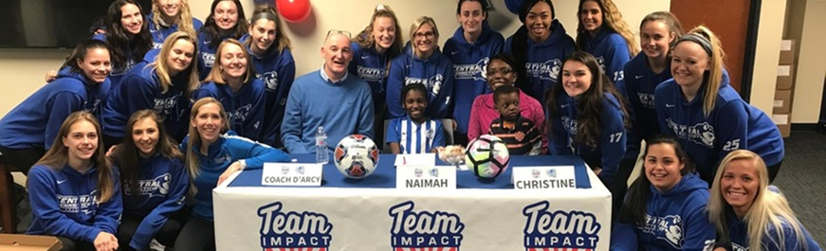
2019-2020 Topics Reviewed: Engagement
Student Athlete Community Engagement
6 or 7 teams have joined “Team Impact”
3-day networking workshop in Boston, Team Impact is looking for 3 CCSU Student-Athletes; very cool opportunity!

Slide 5
2019-2020 Topics Reviewed: Social/Emotional Well-being of our student athletes
Student-athletes had mandatory screening of documentary on opioid crisis
Fall speaker (NEC-provided) LGBTQ diversity speaker/former basketball player

Slide 6
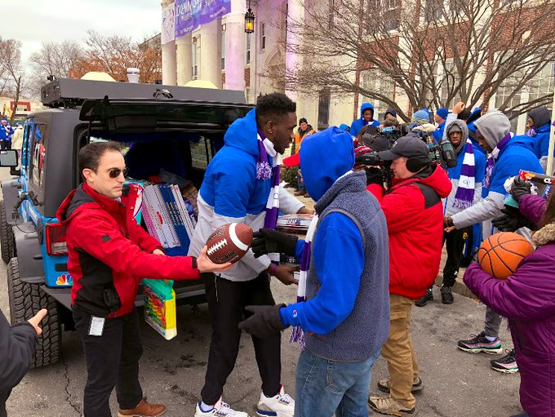
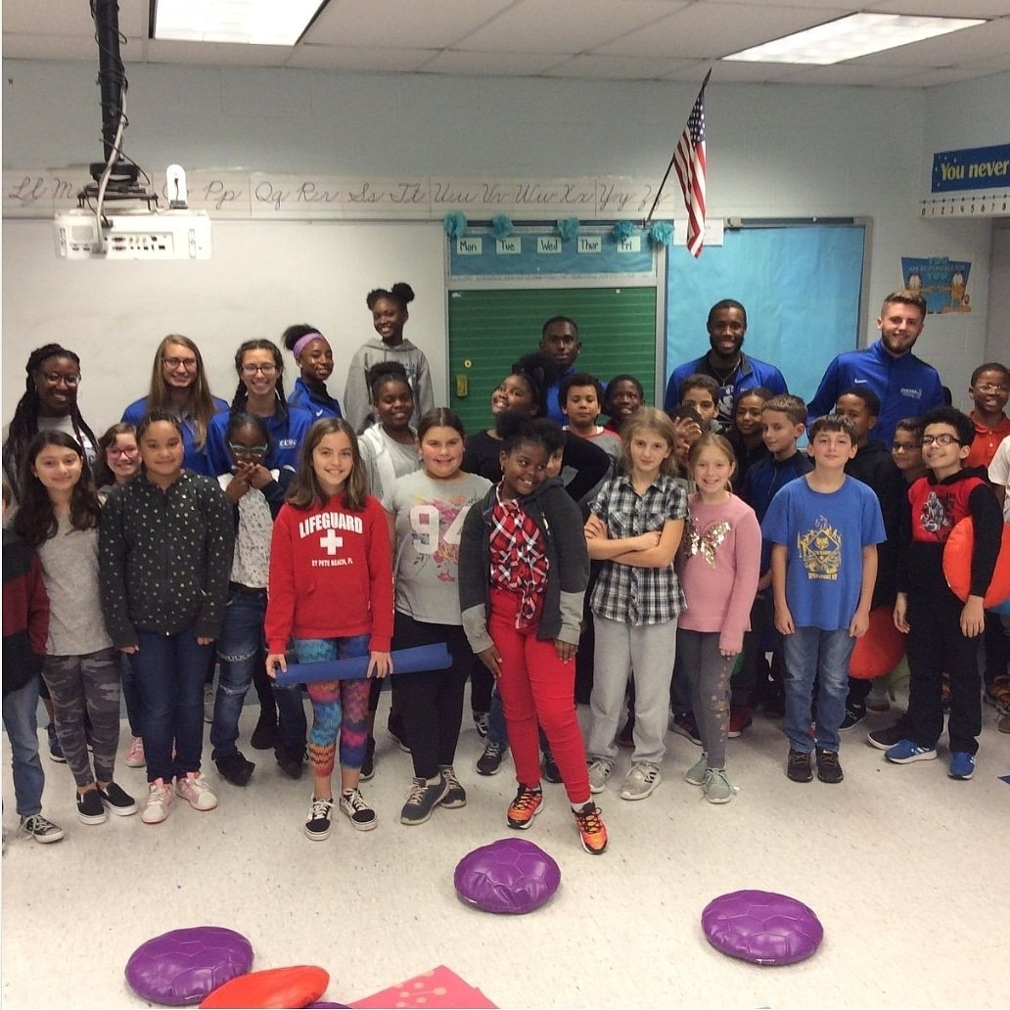
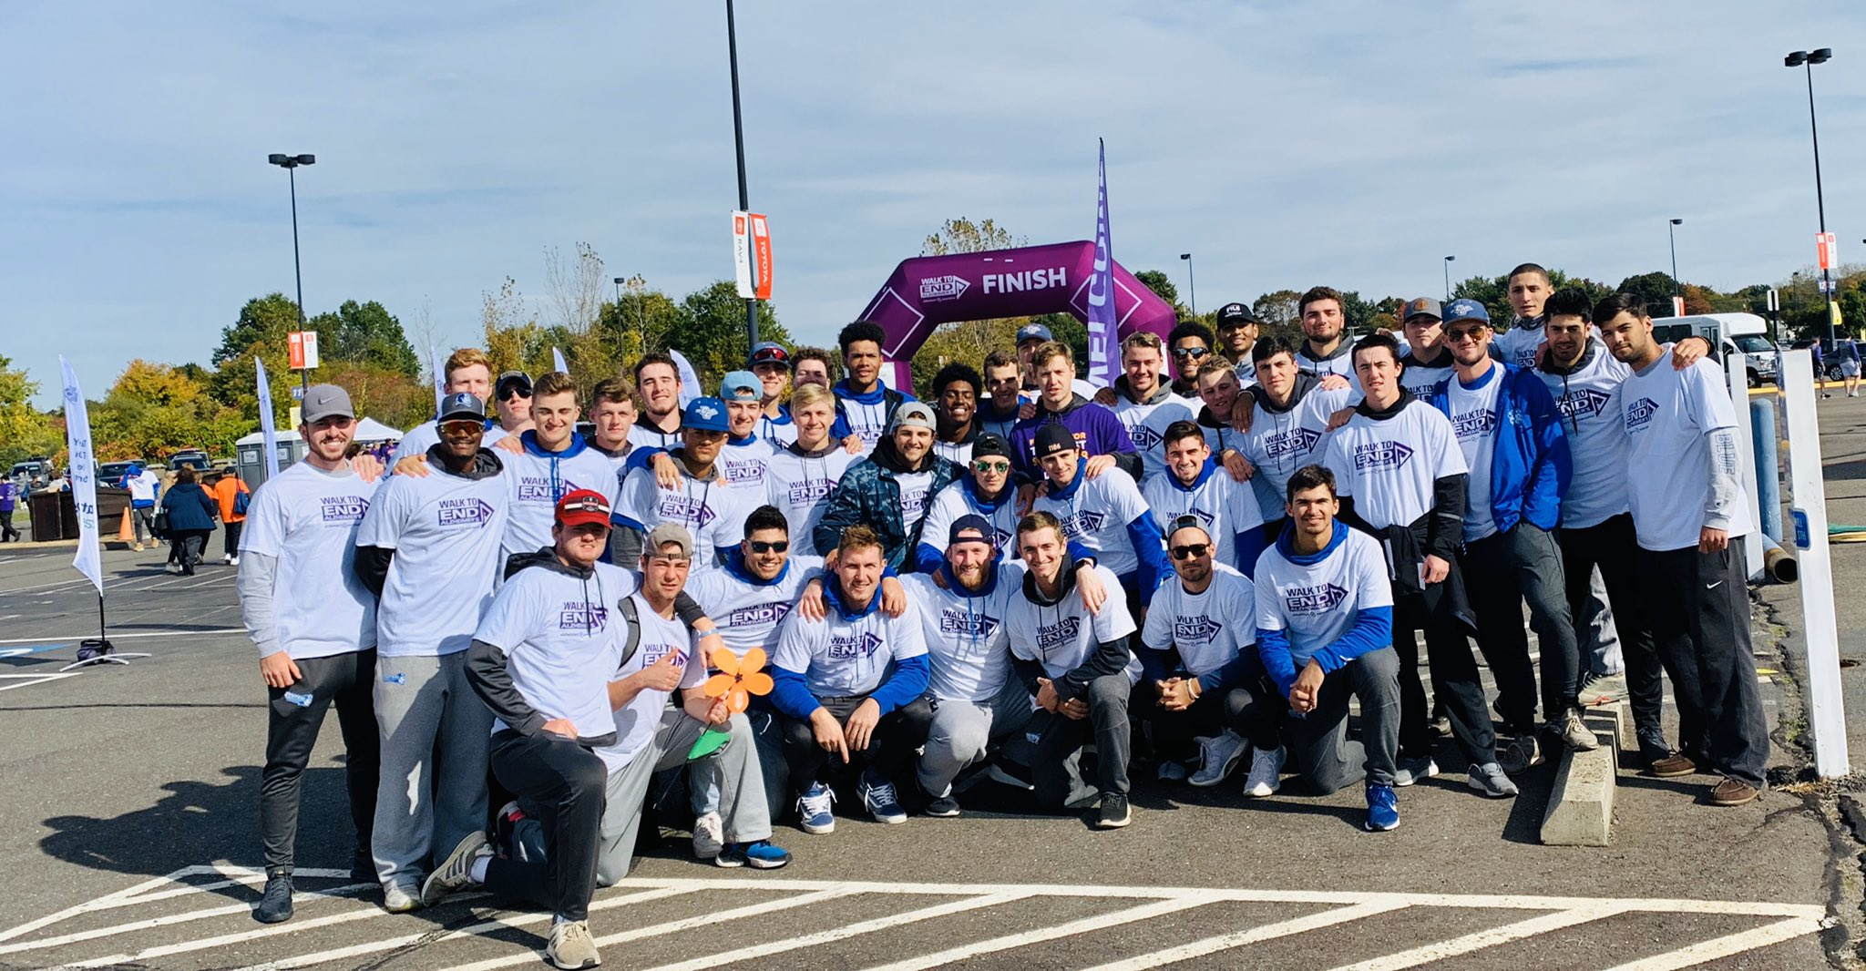
2019-2020 Topics Reviewed: Engagement
Student-athlete engagement;
Anna Grace Project
Open House
Alzheimer's Walk,
Holmes Elementary School
Smalley Elementary School
Farm Hill Elementary School
And More

Slide 7
2019-2020 Topics Reviewed: APR
CCSU is averaging a 963- which is poor; teams below 985 should take a hard look at what they are doing (985 is the threshold for earning additional funds)
Coaches need an active role in the APR process
Calls for increased attention to the academic profile of incoming student-athletes, as well as how we can raise APR
Forward Progress (a third party) did a deep-dive into APR data
One benefit of this is asking for adjustments/corrections; findings ways to improve
Amy Strickland finished final APR report, secured additional points in football for players who came back and completed their degrees.

Slide 8
2019-2020 Topics Reviewed: Successes
ACADEMIC AWARDS
Northeast Conference Academic Honor Roll (3.2+ GPA) – Total – 127 CCSU Student Athletes; Fall – 66; Winter – 57; Spring – TBD
Northeast Conference Commissioner’s Honor Roll (3.75+ GPA) – Total - 38 CCSU Student Athletes; Fall - 21; Winter – 17; Spring – TBD
Erica Bardes (NEC Women’s Soccer Scholar-Athlete of the Year, Scholar All-Region 2nd Team)
Angie Rafter (NEC Women’s Cross Country Scholar-Athlete of the Year)
Men’s/Women’s Cross Country (USTFCCCA All-Academic Team)

Slide 9
2019-2020 Topics Reviewed: Academic Support
Mid-term academic meetings with student athletes below 2.0
K. Oliva reports that students are getting a lot out of the process, keeping students on track with subsequent individual meetings
Early academic warnings are extremely helpful as well
Mid-term reports from Professors are very helpful. Athletics is very thankful for the efforts that professors put into completing these reports.

Slide 10
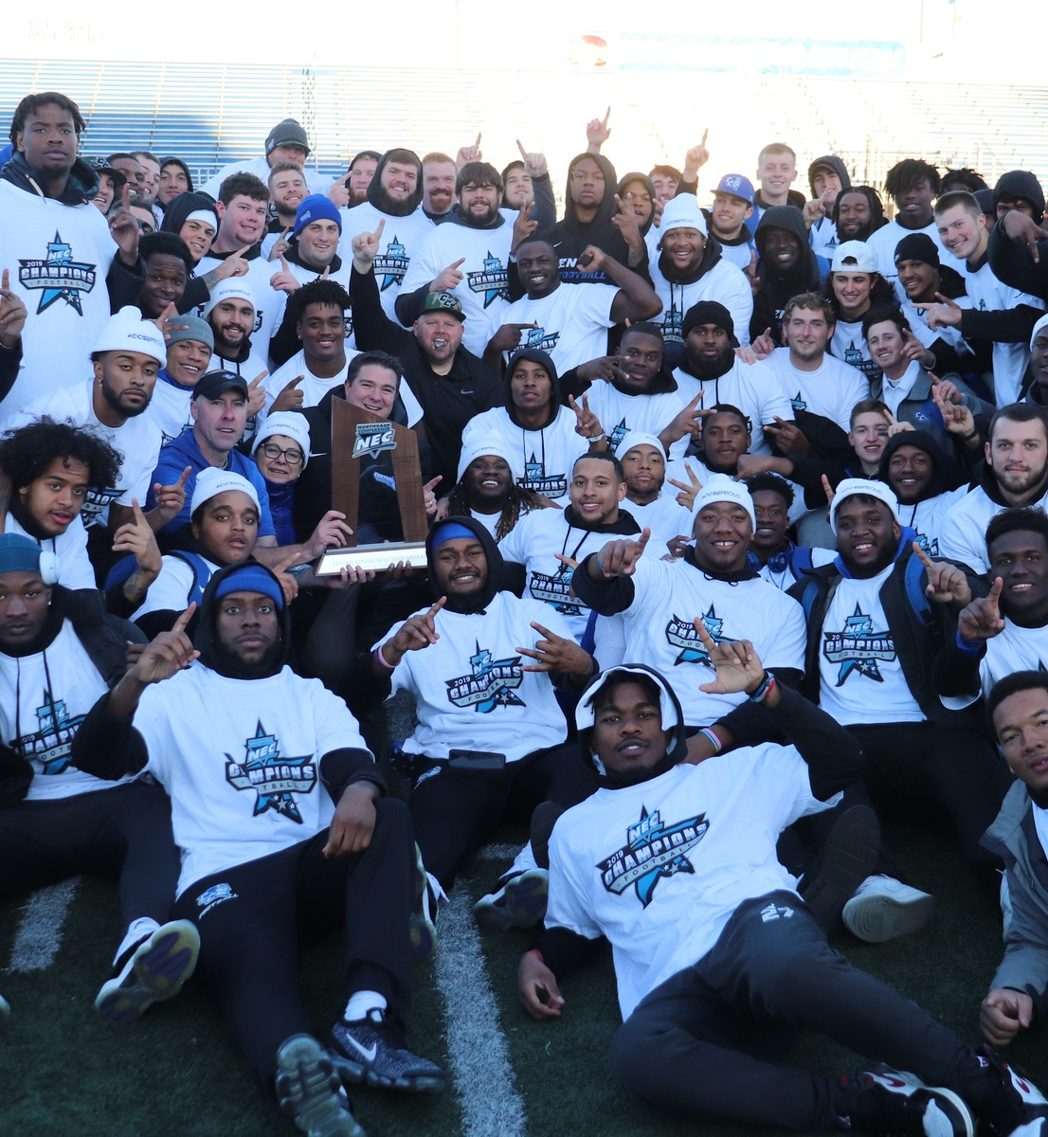
2019-2020 Topics Reviewed: Successes
Northeast Conference(NEC)Championships
  Women’s Soccer
  Women’s Cross Country
  Football

Slide 11
2019-2020 Topics Reviewed: Successes
NORTHEAST CONFERENCE PLAYERS OF THE YEAR 10 total awards
  Men’s Cross Country – Roberto Piotto (Most Outstanding Performer), Elias Field (Freshman of the Year)
  Women’s Cross Country – Angie Rafter (Most Outstanding Performer), Brooke Morabito (Freshman of the Year)
  Football – Aaron Winchester (Offensive Player of the Year)
  Women’s Soccer – Shauny Alterisio (Defensive Player of the Year), Roma McLaughlin (Midfielder of the Year)
  Volleyball – Ashlyn Eisenga (Defensive Player of the Year)
  Women’s Indoor Track & Field – Angie Rafter (Co-Most Outstanding Performer – Distance), Megan Brawner (Co-Most Outstanding Performer – Distance)

Slide 12
2019-2020 Topics Reviewed: Successes
ALL-REGION/ALL-AMERICA RCOGNITION
15 total awards
Women’s Soccer – Roma McLaughlin (United Soccer Coaches All-America 2nd Team, All-Region 1st Team, ECAC All-Star, All-New England 1st Team), Shauny Alterisio (All-Region 2nd Team, ECAC All-Star, All-New England 1st Team), Erica Bardes (All-Region 2nd Team, All-New England 2nd Team), Amanda McQuillan (All-New England 3rd Team), Yo Tachibana (All-New England 3rd Team)
Football – Tajik Bagley (NEFW All-New England 1st Team), Connor Mignone (All-ECAC 2nd Team), Tre Jones (NEFW All-New England 1st Team, All-ECAC 2nd Team)

Slide 13
2019-2020 Topics Reviewed: Successes
COACH OF THE YEAR
7 total awards
Eric Blake (NEC Women’s Cross Country)
Mick D’Arcy (NEC Women’s Soccer, ECAC, United Soccer Coaches Regional Coaching Staff of the Year)
Ryan McCarthy (NEC Football, Gridiron Club of Greater Boston Division I Coach of the Year)

Slide 14
2019-2020 Topics Reviewed: Legislation
We are watching regulations about men’s soccer, which is making a push to span fall and spring semesters; NEC is not supportive of this. For CCSU, the discussion is around finances (spring games means traveling south, strain on support staff for both fall and spring)
Image and Likeness Legislation – student-athletes can’t use likeness for profit, CA is pushing to allow use of likeness.
NCAA is feeling pressure from states, rules are still the same for now

Slide 15
2019-2020 Topics Reviewed: Legislation
The Board of Governors on Tuesday April 28, 2020 outlined the specific areas in which college athletes could be compensated for the use of their name, image and likeness. When approved by the membership, these rules would allow:
Compensation for third-party endorsements related to athletics, without school or conference involvement.
Compensation for other student-athlete opportunities, such as social media, new businesses and personal appearances, without institutional involvement or the use of trademarks/logos.

Slide 16
2019-2020 Topics Reviewed: Budget
Budget
  Progress in terms of budget direction; stable in terms of scholarships
  Base funding is a concern (enrollment drop = cuts to Athletics budget)
  Challenge is that Athletics starts in the red, fundraises for O.E.
  Recently made progress taking back costs associated with facilities, getting tuition differential on scholarships
  80% of budget goes to salary, fringe, scholarships
New Revenue Initiatives
Outsourced corporate sponsorship (This did not workout and the agreement was terminated.
Blue Devils Athletic Club (will assist with private fundraising)
Homecoming attendance was the highest ever. Excellent event.

Slide 17
2019-2020 Topics Reviewed: Revenue Sharing
NCAA Academic Unit Distribution
New grant distribution related to academic performance; there are numerous ways to meet performance metrics (APR requirement, graduation success rate)
APR 985 Requirement
CCSU is focusing on the APR route, 985 average required

Slide 18
2019-2020 Topics Reviewed: Covid-19
NCAA COVID-19 Updates
• Conferences – and possibly institutions – may only receive 60% of annual funding from NCAA
• NCAA estimates they lost approximately $600,000,000 from cancelling March Madness
• NCAA council will be meeting to discuss extending eligibility of seniors
NEC announced cancellation of all games after March 13, 2020
CCSU Summer Camps cancelled
• Student-athletes can only do workouts on a voluntary basis
• COVID-19 has created a lot of unknowns; there are still many moving parts
Supporting CCSU Student-Athletes
• Coaches are reaching out to student-athletes – offering support/mental health tips
• Tutors are connecting with students online
• Advising happened virtually

